Slide 1
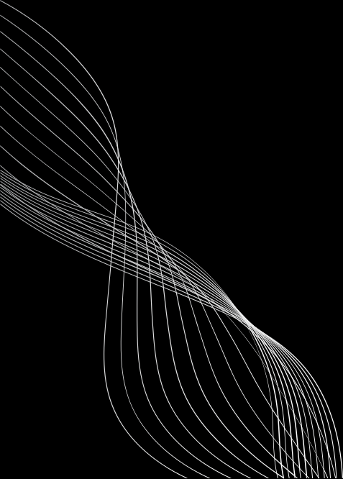


Digital Portfolio
STUDENT NAME: SADHANA.C
REGISTER NO AND NMID: asunm1112401111033033
DEPARTMENT: BCA
COLLEGE: L.N. Government College, madras university

Slide 2
PROJECT TITLE
Digital portfolio using front end web development

Slide 3
AGENDA
1.Problem Statement
2.Project Overview
3.End Users
4. Tools and Technologies
5. Portfolio design and Layout
6.Features and Functionality
7.Results and Screenshots
8.Conclusion
9.Github Link

Slide 4
PROBLEM STATEMENT
In today's world, traditional resumes and CVs are no longer enough Recruiters and clients want to see real work and practical applications.Students often struggle to present academic projects in a professional format. Job seekers need a platform that goes beyond plain text documents. Many professionals lack a central place to highlight their skills and experience.A digital portfolio solves this gap by combining resumes, projects, and skills in one place.It also offers interactivity with visuals, animations, and structured content. Without a portfolio, opportunities may be lost due to weak first impressionsxt

Slide 5
PROJECT OVERVIEW
1.This project is about creating a student digital portfolio website.
2. The portfolio is a professional, structured, and interactive website
3. It begins with a Home section, giving an introduction and call-to-action
4. The About section highlights career goals, personal details, and passions
5. The Skills section lists technical abilities like HTML, CSS, JavaScript, and Python
6. The Projects section showcases practical works such as Al chatbots, web apps, and designs.

Slide 6
END USERS
The portfolio is designed for a wide range of users
Students can use it to showcase academic projects, resumes, skills
Job seekers can share their portfolio links directly with recruiters
Instead of long attachments, recruiters can see work live on a website
Freelancers can show completed projects to attract clients.
It acts as a project gallery, demonstrating creativity and professionalism.

Slide 7
TOOLS AND TECHNIQUES
The portfolio is built using core web development tools.
HTML provides the structure of pages and sections.
CSS adds styling, colors, layouts, and responsiveness for all devices.
JavaScript ensures interactivity such as navigation, animations, and form validation.
The project uses modern coding practices for better performance.
Code editors like VS Code and CodePen were used for development.

Slide 8
POTFOLIO DESIGN AND LAYOUT
The design follows a clean and modern layout.
The Home section welcomes visitors with a professional intro.
The About section shares career goals, skills, and aspirations.
The Skills section lists technical knowledge and tools used.
The Projects section shows sample works with images and details.
Each project card includes titles, descriptions, and live demo links.
The Contact section provides a form and clickable links for communication.
The design is fully responsive, ensuring accessibility on any screen.
Smooth navigation allows visitors to reach sections easily.

Slide 9
FEATURES AND FUNCTIONALITY
1.The portfolio provides easy navigation with a clean interface.
2.Projects are displayed with visual appeal and animations.
3.It creates a memorable first impression for recruiters and clients.
4.Visitors can explore skills, projects, and achievements in one place.
5.The website works on all devices, from laptops to smartphones.
6.The contact form allows direct communication with potential employers.7.It boosts professional credibility and builds trust with recruiters.h text

Slide 10
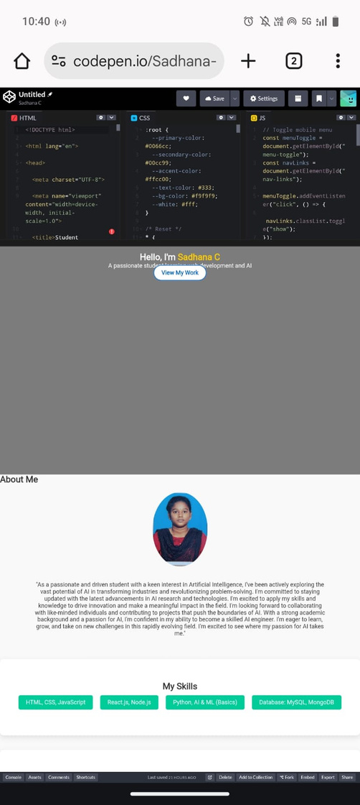
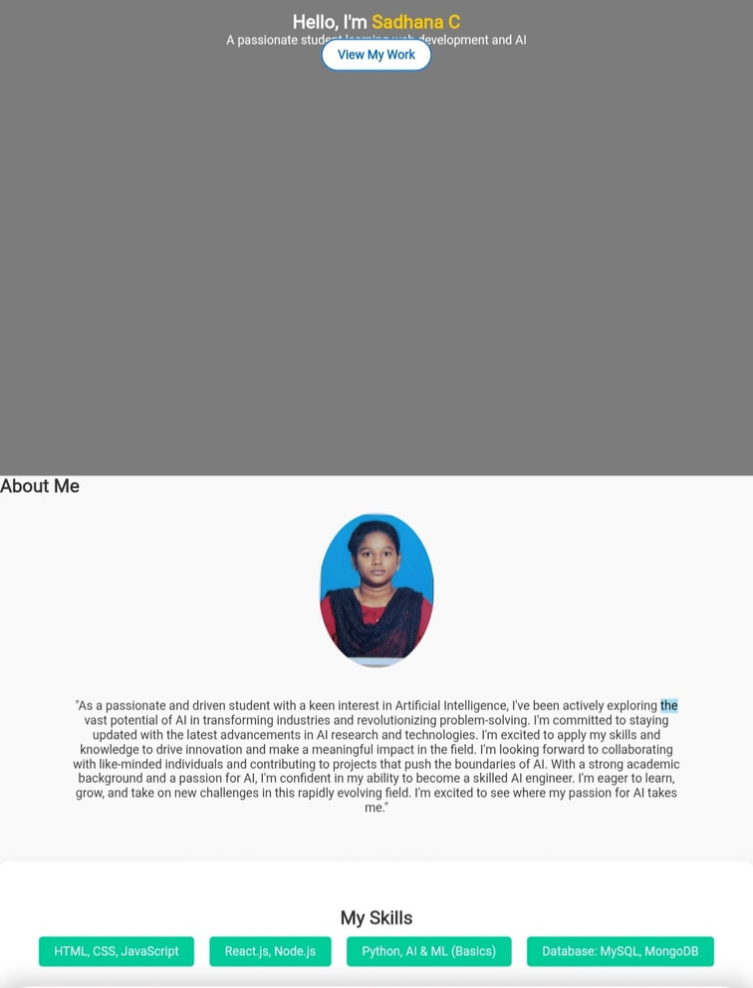
RESULTS AND SCREENSHOTS
Built an interactive personal
portfolio using HTML,
CSS, JavaScript,
and React.js.

Slide 11
CONCLUSION
digital portfolio is a modern replacement for traditional resumes.
It provides an interactive and professional identity.
The project demonstrates knowledge of HTML, CSS, and JavaScript.
It shows the ability to design and develop responsive websites.
The portfolio highlights achievements, skills, and real-world projects
It is useful for students, job seekers, freelancers, and professionals.
Recruiters and clients gain confidence by seeing actual work samples.
The portfolio boosts career opportunities and academic visibility.

Slide 12
GitHub link
https://sadhana1412.github.io/My-portfolio-/

